Slide 1



15 April, 2024
Club Navigator Plus
A one stop solution for
your extracurricular endeavours

Slide 2

Introduction
Club Navigator Plus is a Python project developed to help users discover clubs that match their interests and passions. It offers a personalized aptitude test to recommend clubs based on user preferences. With Club Navigator Plus, users can explore a variety of clubs, enhancing their college experience.

Slide 3



OBJECTIVES

Slide 4

Project Objectives
Informed Decision Making
Reduce Information Overload
Enhance Club Experience
Help freshmen make informed decisions about joining clubs by providing them with personalized club recommendations based on their interests and preferences.
Reduce the information overload faced by freshmen during club recruitment by presenting club information in a structured and easily digestible format
Enhance the overall club experience for freshmen by matching them with clubs where they are more likely to enjoy and contribute meaningfully.
Notes:
Based on your vision, here are some objectives for your project:
1. **Informed Decision Making**: Help freshmen make informed decisions about joining clubs by providing them with personalized club recommendations based on their interests and preferences.
2. **Reduce Information Overload**: Reduce the information overload faced by freshmen during club recruitment by presenting club information in a structured and easily digestible format.
3. **Increase Club Engagement**: Increase freshmen's engagement with clubs by matching them with clubs that align with their interests, increasing the likelihood of active participation.
4. **Improve Academic Performance**: Improve freshmen's academic performance by helping them choose clubs that complement their academic goals and schedule, reducing the time spent on clubs that do not align with their interests.
5. **Enhance Club Experience**: Enhance the overall club experience for freshmen by matching them with clubs where they are more likely to enjoy and contribute meaningfully.
6. **Promote Long-Term Commitment**: Promote long-term commitment to clubs by ensuring that freshmen join clubs that match their long-term interests and aspirations.
These objectives aim to address the challenges faced by freshmen during club recruitment and help them make more informed and meaningful club choices. If you have specific aspects you'd like to focus on or if there are other objectives you have in mind, please let me know for further input!

Slide 5

Tech Stack

Slide 6

Tech Stack
Front End
Back End
Database
HTML/CSS: Used for structuring and styling the user interface, ensuring a visually appealing and responsive design.
JavaScript: Implemented for interactive elements and dynamic content, enhancing the user experience with features like dynamic forms and animations.
Python: Utilized for backend development, including handling business logic, user authentication, and integrating frontend components.
2. Django: Chosen as the web framework for Python, providing a robust and scalable architecture for building web applications.
SQLite: Used as the database management system for storing user data, club information, and test results, offering a lightweight and efficient solution.
Django has Integrated SQLite to provide an object-relational mapping forsimplifying database operations.
Notes:
Certainly! Here are six points for the tech stack used in Club Navigator Plus:
**Frontend:**
1. **HTML/CSS**: Used for structuring and styling the user interface, ensuring a visually appealing and responsive design.
2. **JavaScript**: Implemented for interactive elements and dynamic content, enhancing the user experience with features like dynamic forms and animations.
**Backend:**
1. **Python**: Utilized for backend development, including handling business logic, user authentication, and integrating frontend components.
2. **Django**: Chosen as the web framework for Python, providing a robust and scalable architecture for building web applications.
**Database:**
1. **SQLite**: Used as the database management system for storing user data, club information, and test results, offering a lightweight and efficient solution.
2. **Django ORM**: Integrated with SQLite to provide an object-relational mapping for database operations, simplifying data management and ensuring data integrity.
These technologies were selected to create a seamless and efficient platform for Club Navigator Plus, providing a user-friendly interface, robust backend functionality, and reliable data storage and management.

Slide 7
OOPs Concepts
Classes and Objects
Abstraction
Encapsulation and Inheritance
Model Classes: In Django, models are defined as Python classes that subclass `django.db.models.Model`.
Each attribute of the class represents a database field, and each instance of the class represents a record in the database.
.
Django provides a high level of abstraction over the underlying web server and database.
Developers interact with Django's API, which abstracts away the complexities of handling HTTP requests, database queries, and other low-level tasks.
.
Views in Django are Python functions or classes that receive web requests and return web responses.
Django's class-based views (CBVs) promote reuse and encapsulation by allowing developers to define common behaviors in base view classes and then inherit from them to create specific views.

Slide 8
Key Features
Personalized Club Recommendations:
A system that provides personalized club recommendations to users based on their interests and preferences.
Dynamic Aptitude Test:
A dynamic aptitude test that adapts based on users' previous answers, ensuring a tailored experience.
User Authentication
Created a secure login system to authenticate users and provide access to the aptitude test and club recommendations.

Slide 9
Key Features
Dashboard:
A Dashboard where users can view recommended clubs after taking the aptitude test
Club Information Display:
We display comprehensive information about each club, including descriptions, meeting times, events, and contact details.
Engagement:

Slide 10
Screenshots of the Website

Slide 11
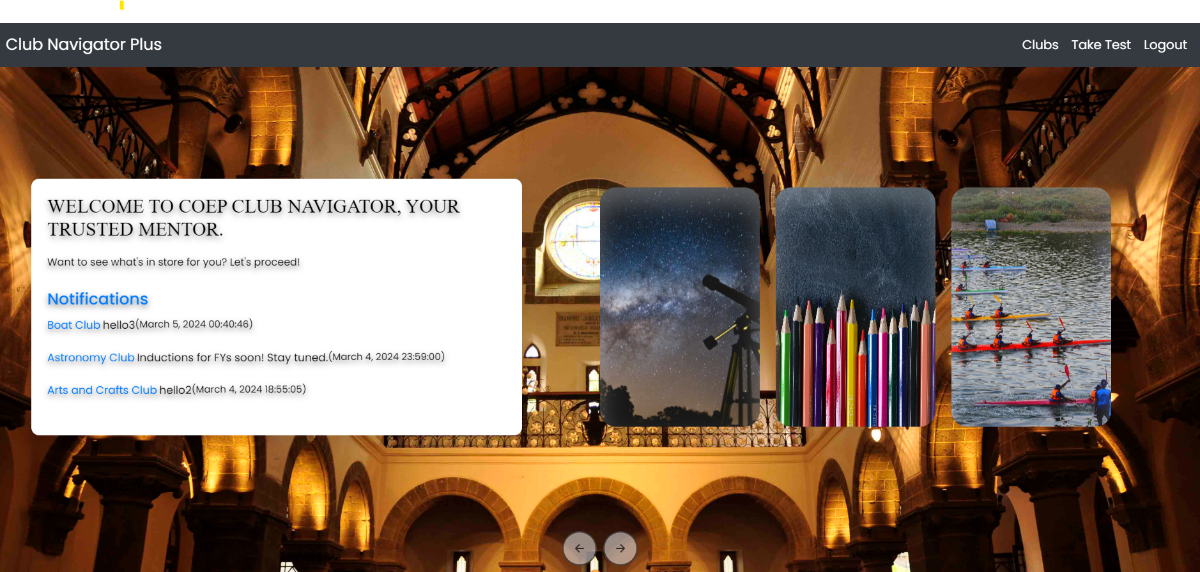
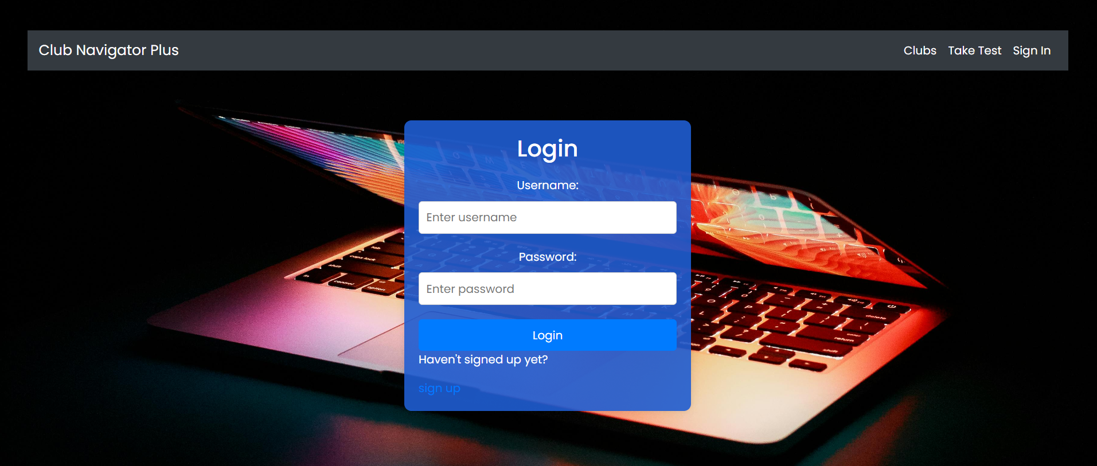

Slide 12
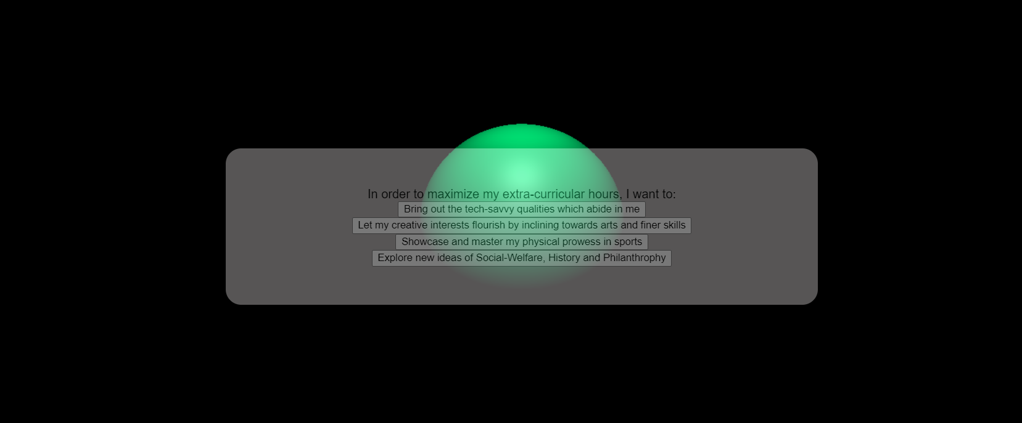
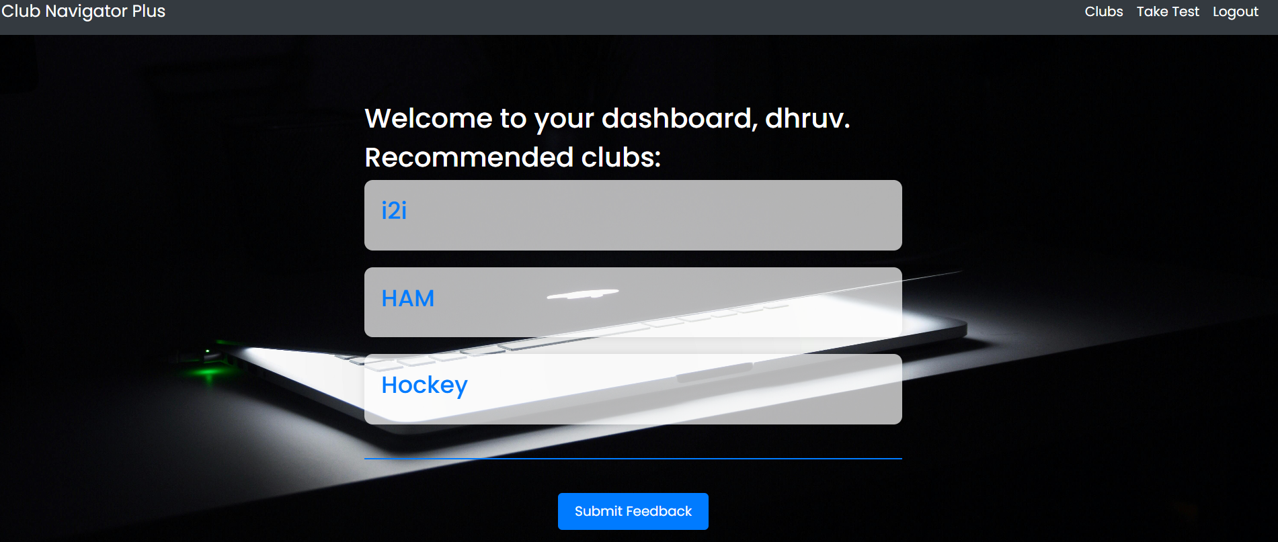

Slide 13
Thank you
MIS : 612203043 and 612203060

